Slide 1
Mastering NT Greek
14. Second Aorist Verbs
By Ted Hildebrandt © 2003
Baker Academic

Slide 2
2-1-2 Paradigms - Chant this
2 1 2
λόγος γραφή ἱερόν
λόγου γραφῆς ἱεροῦ
λόγῳ γραφῇ ἱερῷ
λόγον γραφήν ἱερόν
λόγοι γραφαί ἱερά
λόγων γραφῶν ἱερῶν
λόγοις γραφαῖς ἱεροῖς
λόγους γραφάς ἱερά

Slide 3
3rd Declension Chantables
χαρίς ὄνομα, πίστις
χάρις ὄνομα πίστις
χάριτος ὀνόματος πίστεως
χάριτι ὀνόματι πίστει
χάριτα ὄνομα πίστιν
χάριτες ὀνόματα πίστεις
χαρίτων ὀνομάτων πίστεων
χάρισι(ν) ὀνόμασι(ν) πίστεσι(ν)
χάριτας ὀνόματα πίστεις

Slide 4
PAI Verb Chant
λύω λύομεν
λύεις λύετε
λύει λύουσι(ν)

Slide 5
The "is" verb PAI -- εἰμί
εἰμί ἐσμέν
εἶ ἐστέ
ἐστί(ν) εἰσί(ν)

Slide 6
Imperfect εἰμί
ἤμην ἦμεν
ἦς ἦτε
ἦν ἦσαν

Slide 7
Person Personal Pronoun Chant
Singular Plural
Nom. ἐγώ σύ ἡμεῖς
Gen. μου σου ἡμῶν
Dat. μοι σοι ἡμῖν
Acc. με σε ἡμάς
αὐτός, αὐτη, αὐτό (he, she, it)

Slide 8
Present Middle/Passive Indicative
λύομαι, -ομεθα
-ῃ, -εσθε
-εται, -ονται
I am loosed/am being loosed
I loose myself/am loosing [for myself]

Slide 9
Shape of the Future in Greek
λύσω λύσομεν
I will loose We will loose
λύσεις λύσετε
You will loose You all will loose
λύσει λύσουσι(ν)
S/he/it will loose They will loose
Chant this one

Slide 10
Future Middle Paradigm
λύσομαι -όμεθα
-ῃ -εσθε
-εται -ονται
I will loose (for myself) We will loose (for ourselves) …

Slide 11
Demonstrative and Relative Pronouns Summary
ἐκεῖνος, ἐκείνη, ἐκεῖνο = that
οὗτος, αὕτη, τοῦτο
τούτου, ταύτης, τούτου = this
ὅς ἥ ὅ = Relative (who, which)
οὗ ἧς οὗ

Slide 12
Imperfect Active Paradigm of λύω
Chant: ἐλυον, ν, ς, ε, μεν, τε, ν
I was loosing, …

Slide 13
Imperfect Middle/Passive (IM/PI)
Chant: ἐλυόμην
ου, ετο, ομεθα, εσθε, οντο
I was being loosed

Slide 14
Rapping the Lord’s Prayer
Πάτερ ἡμῶν ὁ ἐν τοῖς οὐρανοῖς
father our the one in heaven
ἁγιασθήτω τὸ ὄνομά σου
make holy name your
ἐλθέτω ἡ βασιλεία σου
let come kingdom your
γενηθήτω τὸ θέλημά σου,
let be will your

Slide 15
English Parallels
1) Past tense in English if often formed by adding "ed"
  I talk to Zach about basketball. (present)
  I talked to Zach about basketball. (past)
2) Change the stem form of the verb:
  I swim in the pool. (present)
  I swam in the pool. (past)
Second aorist is a shift in the stem.

Slide 16
The Aorist - Past tense
The aorist is the most frequently used tense in the NT
The first aorist is formed by adding an augment on front and a sa in the back.
The second aorist involves a stem change.
Aorist is complete/whole action (it happened) as opposed to the imperfect which is process action (He loosed. He was loosing).

Slide 17
Second Aorist Form
Stem Change Aorist
The stem change just has to be learned
Augment + Verb Stem + CV + Secondary endings
ε + λαβ + ο + ν
Connecting vowels:
  ο before μ and ν
  ε elsewhere

Slide 18
Augment Review
1) Before consonant = ε
2) Before a vowel
  1) α and ε lengthen to η
  2) ο lengthens to ω
  3) ι ending a diphthong subscripts
  4) υ ending a diphthong stays itself (ευ)
3) Compound verbs augments after prep.
  ἐκβάλλω == ἐξεβάλον

Slide 19
Second Aorist Active Paradigm λαμβάνω
Singular Plural
1 ἔλαβον ἐλάβομεν
  I took we took
2 ἔλαβες ἐλάβετε
  You took You took
3 ἔλαβε(ν) ἔλαβον
  He/she/it took They took
Know Chant: ἔλαβον
ν, σ, ε, μεν, τε, ν

Slide 20
Second Aorist Middle γίνομαι
Singular Plural
1 ἐγενόμην ἐγενόμεθα
  I became we became
2 ἐγένου ἐγένεσθε
  You became You became
3 ἐγένετο ἐγένοντο
  He/she/it became They became
Note: most "middles" are deponent
Know Chant: ἐγενόμην
-ου, -ετο, -ομεθα, -εσθε, -οντο

Slide 21
Aorist Stem Changes -- 10 to know
ἔρχομαι == ἦλθον (I came, went)
βλέπω == εἶδον (I saw)
λέγω == εἶπον (I said)
γίνομαι == ἐγενόμην (I became)
γινώσκω == ἔγνων (I knew)
ἔχω == ἔσχον ( I had)
λαμβάνω == ἔλαβον (I took)
εὑρίσκω == εὗρον (I found)

Slide 22
Aorist Stem Changes -- 10 to know
ἀπέρχομαι == ἀπῆλθον (I departed)
εἰέρχομαι == εἰσῆλθον (I entered)
ἐξέρχομαι == ἐξῆλθον (I went out)
ἀποθνῄσκω == ἀπέθανον (I died)
βάλλω == ἔβαλον (I threw)

Slide 23
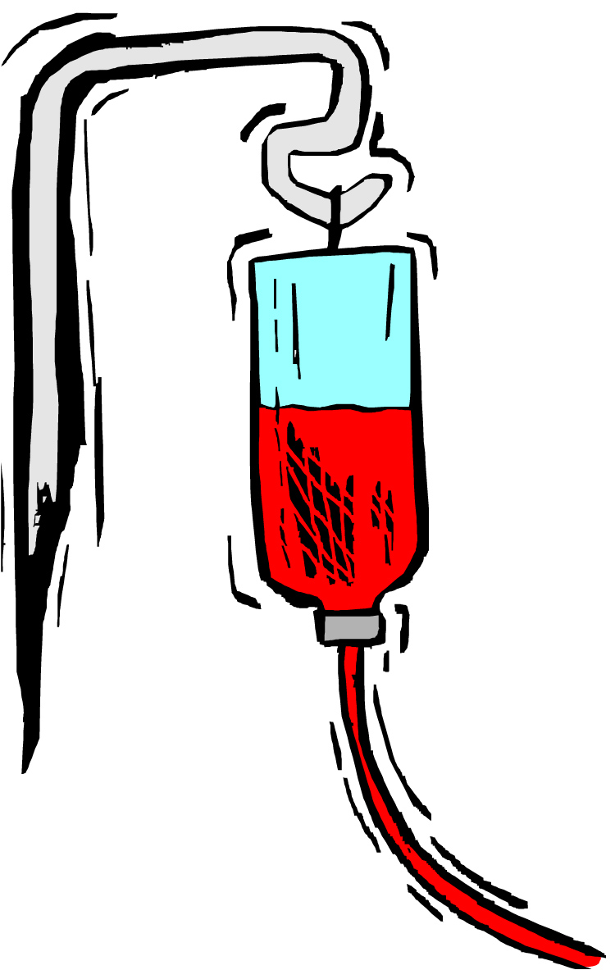
Chapter 14 Vocabulary
αἶμα, -ματος, τό
blood

Slide 24
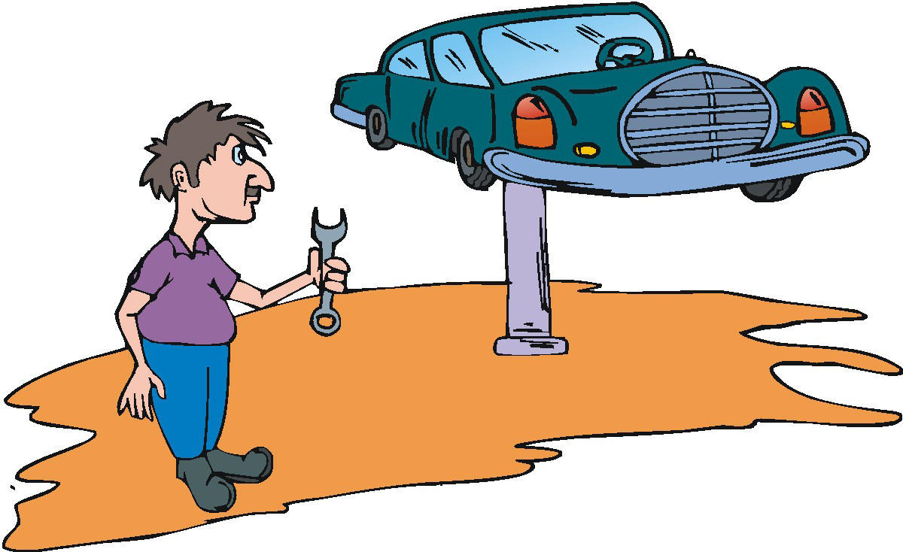
Chapter 14 Vocabulary
αἴρω
I raise,
take up

Slide 25

Chapter 14 Vocabulary
διδάσκω
I teach

Slide 26

Chapter 14 Vocabulary
ἴδιος, -α, -ον
one's own

Slide 27

Chapter 14 Vocabulary
καλός, -ή, -όν
good

Slide 28
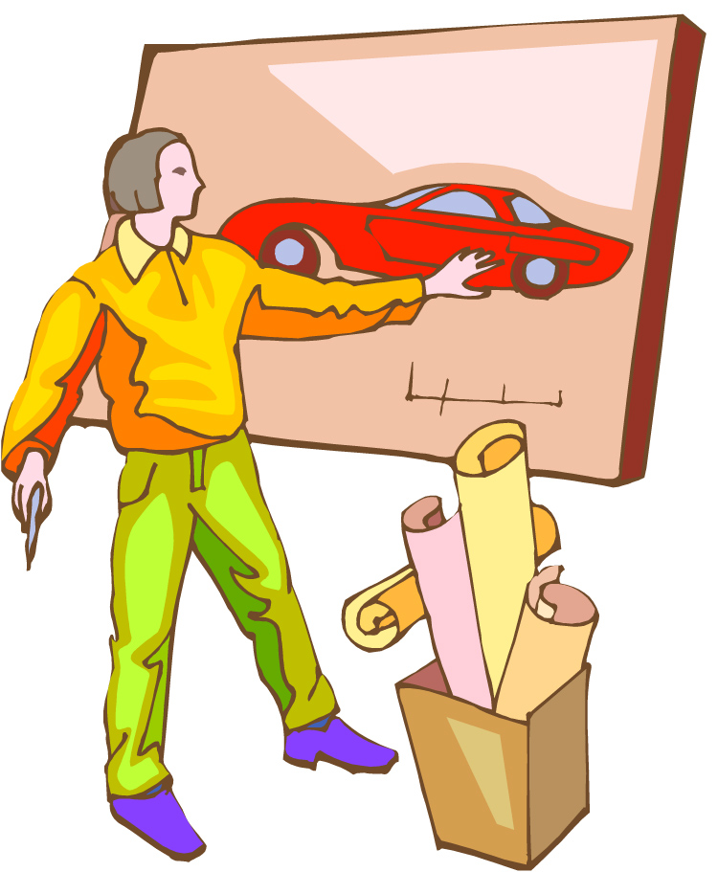
Chapter 14 Vocabulary
μέλλω
I am about to,
intend

Slide 29
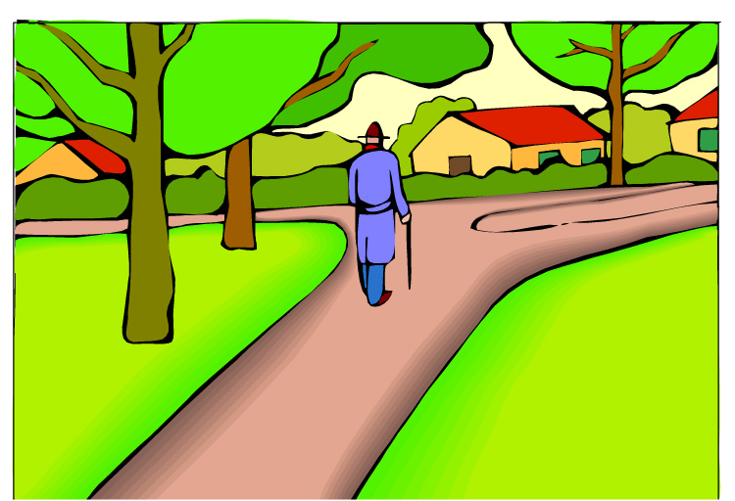
Chapter 14 Vocabulary
ὁδός, -οῦ, ἡ
way

Slide 30

Chapter 14 Vocabulary
πολύς, πολλή, πολύ
much, many

Slide 31
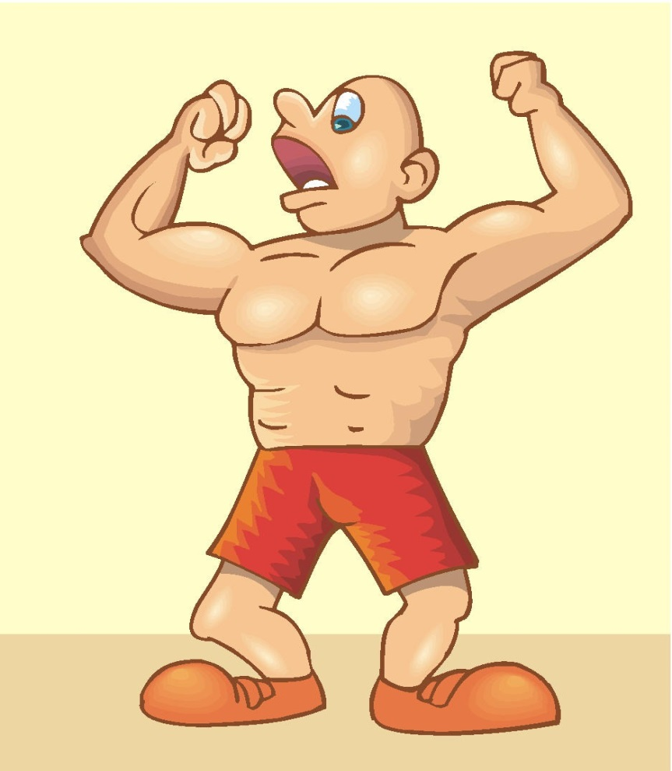
Chapter 14 Vocabulary
σῶμα, -ματος, τό
body

Slide 32

Chapter 14 Vocabulary
ψυχή, -ῆς, ἡ
soul, life

Slide 33
2nd Aorist Bad Boys
ἦλθον
  ἔρχομαι (I came, went)
εἶδον
  βλέπω (I saw)
εἶπον
  λέγω (I said)
ἐγενόμην
  γίνομαι (I became)

Slide 34
2nd Aorist Bad Boys
ἔγνων
  γινώσκω (I knew)
ἔσχον
  ἔχω ( I had)
ἔλαβον
  λαμβάνω (I took)
εὗρον
  εὑρίσκω (I found)

Slide 35
Quick Vocabulary Review

Slide 36
Ch. 1 -- Vocabulary
angel, messenger
      ἄγγελος, -ου, ὁ
verily, truly
      ἀμήν
man, humankind
      ἄνθρωπος, -ου, ὁ
I
      ἐγώ
God
      θεός, -οῦ, ὁ

Slide 37
Ch. 1 -- Vocabulary
and, also, even
    καί
heart
    καρδία, -ας, ἡ
I say
    λέγω
prophet
    προφήτης, -ου, ὁ
Christ, Messiah
    Χριστός, -οῦ, ὁ

Slide 38
Ch. 2 -- Vocabulary
brother
      ἀδελφός, -οῦ, ὁ
I hear, obey
      ἀκούω
glory, fame
      δόξα, -ης, ἡ
I have
      ἔχω
world
      κόσμος, -ου, ὁ

Slide 39
Ch. 2 -- Vocabulary
Lord, sir
      κύριος, -ου, ὁ
word
      λόγος, -ου, ὁ
Peter
      Πἑτρος, -ου, ὁ
son
      υἱός, -οῦ, ὁ
Pharisee
      Φαρισαῖος, -ου, ὁ

Slide 40
Ch. 3 -- Vocabulary
but, yet
      ἀλλἀ
apostle, sent one
      ἀπόστολος, -ου, ὁ
I see
      βλέπω
for, then
      γάρ
I know
      γινώσκω

Slide 41
Ch. 3 -- Vocabulary
Jesus
      Ἰησοῦς, -οῦ, ὁ
I take, receive
      λαμβάνω
I loose
      λύω
heaven
      οὐρανός, -οῦ, ὁ
I believe
      πιστεύω

Slide 42
Ch. 4 -- Vocabulary
      I love
ἀγαπάω
      I write
γράφω
      but, and
δέ
      servant, slave
δοῦλος, -ου, ὁ
      I find
εὑρίσκω

Slide 43
Ch. 4 -- Vocabulary
      temple
ἱερόν, -οῦ, τό
People
λαός, -οῦ, ὁ
      law
νόμος, -ου, ὁ
      house
οἶκος, -ου, ὁ
      as, about, how
ὡς

Slide 44
Ch. 5 -- Vocabulary
      love
ἀγάπη, -ης, ἡ
      truth
ἀλήθεια, -ας, ἡ
      sin
ἁμαρτία, -ας, ἡ
      kingdom
βασιλεία, -ας, ἡ
      writing, Scripture
γραφή, -ῆς, ἡ

Slide 45
Ch. 5 -- Vocabulary
      I raise up
ἐγείρω
      assembly, church
ἐκκλησία, -ας, ἡ
      work
ἔργον, -ου, τό
      disciple
μαθητής, -οῦ, ὁ
      Hour
ὥρα, -ας, ἡ

Slide 46
Chapter 6 Vocabulary
ἀπό (Gen.)
  from
διά (Gen.)
  through
διά (Acc.)
  on account of
εἰς (Acc.)
  into

Slide 47
Chapter 6 Vocabulary
ἐκ (Gen.)
  out of, from
ἐν (Dat.)
  in
ἐπί (Gen.)
  on, over
ἐπί (Dat.)
  on, at, against, on the basis of

Slide 48
Chapter 6 Vocabulary
ἐπί (Acc.)
  on, to, toward, against
κατά (Gen.)
  down, against
κατά (Acc.)
  according to
μετά (Gen.)
  with

Slide 49
Chapter 6 Vocabulary
μετά (Acc.)
  after, behind
περί (Gen.)
  about, concerning
περί (Acc.)
  around, near
πρός (Acc.)
  to

Slide 50
Vocabulary -- Ch. 7
  good
ἀγαθός, -ή, -όν
Holy
ἅγιος, -α, -ον
  righteous
δίκαιοις, -α, -ον

Slide 51
Vocabulary – Ch. 7
  I am
εἰμί
Jewish, a Jew
Ἰουδαῖος, -α, -ον
Great
μέγας, μεγάλη, μέγα

Slide 52
Vocabulary -- Ch. 7
dead
νεκρός, -ά, -όν
no, not
οὐ, οὐκ, οὐχ
first
πρῶτος, -η, -ον
voice
φωνή, -ῆς, ἡ

Slide 53
Vocabulary Ch. 8
he/she/it
  αὐτός, -ή, -ό
land, earth, region
  γῆ, -ῆς, ἡ
I, we
  ἐγώ, ἡμεῖς
day
  ἡμέρα, -ας, ἡ
that, so that
  ὅτι

Slide 54
Vocabulary Ch. 8
so, then, therefore
  οὖν
crowd
  ὄχλος, -ου, ὁ
from
  παρά (with Gen.)
beside, with
  παρά (with Dat.)
alongside, beside
  παρά (with Acc.)

Slide 55
Vocabulary Ch. 8
you / you (pl)
  σύ / ὑμεῖς
by, at the hands of
  ὑπό (with Gen.)
under, below
  ὑπό (with Acc.)

Slide 56
Vocabulary Ch. 9
I answer
  ἀποκρίνομαι
I send
  ἀποστέλλω
I throw
  βάλλω
I become
  γίνομαι
I come in
  εἰσέρχομαι

Slide 57
Vocabulary Ch. 9
I go out
  ἐξέρχομαι
I come/go
  ἔρχομαι
I wish
  θέλω
thus, so
  οὕτως
I go
  πορεύομαι

Slide 58
Vocabulary Ch. 10
life
  ζωή, -ῆς, ἡ
death
  θάνατος, -ου, ὁ
I judge
  κρίνω
I remain
  μένω
only, alone
  μόνος, -η, -ον

Slide 59
Vocabulary Ch. 10
now
  νῦν
and not, nor
  οὐδέ
Paul
  Παῦλος
I save
  σῴζω
then
  τότε

Slide 60
Chapter 11 Vocabulary
ἀπέρχομαι
  I go away, leave
ἐκεῖνος
  that
Ἰουδαῖος, -α, -ον
  Jewish
καθώς
  as, just as

Slide 61
Chapter 11 Vocabulary
ὅς, ἥ, ὅ
  who, which
ὅταν
  when
πάλιν
  again
οὗτος, αὗτη, τοῦτο
  this

Slide 62
Chapter 11 Vocabulary
Πέτρος, -ου, ὁ
  Peter
ὑπέρ
  for, about (gen.)
  above, beyond (acc.)

Slide 63
Chapter 11 Vocabulary
ὑπέρ
  for, about (gen.)
  above, beyond (acc.)

Slide 64
Chapter 12 Vocabulary
ἀποθνῄσκω
  I die
ἐκεῖ
  there
ἕως
  until
ἰδού
  behold

Slide 65
Chapter 12 Vocabulary
ἵνα
in order that, that
Ἰωάννης, -ου, ὁ
  John
μέν
  on the one hand, indeed
ὅλος, -η, -ον
  whole, entire

Slide 66
Chapter 12 Vocabulary
ὅτε
  when
σύν
  with

Slide 67
Chapter 13 Vocabulary
ἀνήρ, ἀνδρός, ὁ
    man, husband
βασιλεύς, -ἐως, ὁ
    king
δύναμις, -εως, ἡ
    power, miracle
ὄνομα, -ματος, τό
    name
πᾶς, πᾶσα, πᾶν
    each, every, all

Slide 68
Chapter 13 Vocabulary
πατήρ, πατρός, ὁ
    father
πιστις, πίστεως, ἡ
    faith, belief
πνεῦμα, -ατος, τό
    spirit, wind
σάρξ, σαρκός, ἡ
    flesh, body
χάρις, -ιτος, ἡ
    grace, kindness

Slide 69
Aorist Bad Boys
ἔσχον
ἔχω ( I had)
ἦλθον
ἔρχομαι (I came, went)
εἶπον
λέγω (I said)
ἀπῆλθον
ἀπέρχομαι (I departed)

Slide 70
Aorist Bad Boys
ἔγνων
γινώσκω (I knew)
ἔλαβον
λαμβάνω (I took)
εἶδον
βλέπω (I saw)
ἀπῆλθον
ἀπέρχομαι (I departed)

Slide 71
Aorist Bad Boys
εἰσῆλθον
εἰσέρχομαι (I entered)
ἐξῆλθον
ἐξέρχομαι (I went out)
ἀπέθανον
ἀποθνῄσκω (I died)
εὗρον
εὑρίσκω (I found)

Slide 72
Aorist Bad Boys
ἔβαλον
βάλλω (I threw)

